Slide 1

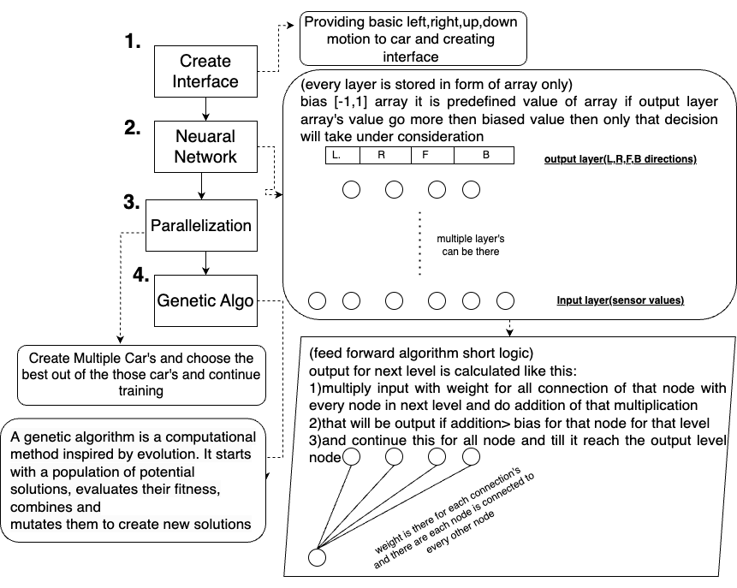
Department of Computer Engineering
Course Code CSM 501 Mini Project: 2 A
Academic Year 2023-2024
Title: Self Driving Car
Group ID.: T09
Omkar Patil
Deep Salunkhe
Pranav Redij
Sukant Thombare
Avinash Shrivas
Abstract
Methodology :
Results
Now-a-days, Self driving cars are introduce with rapid developing technology. Developing and testing self deriving cars are life threatening and can be more cost effective. This project presents the virtual self driving simulation using Java script and feed forwarding neural network to navigate the car without colliding. This Simulation environment provides safe and efficient way to train and test self-driving car algorithms. The neural network is trained by trial and error learnings.
Environment Setup: Created the simulation environment using HTML, CSS, and canvas. Defined car properties and controls in JavaScript.
Sensor Integration: Added sensors for object detection and implemented collision detection.
Neural Network Introduction: Introduced neural networks for decision-making, inspired by the human brain. Developed a neural network with input and output layers, weights, and biases.
Sensor-Network Connection : Integrated car sensors with the neural network, adjusting inputs to represent object proximity.Implemented a visualization canvas to aid in network debugging.
Parallelization and Traffic : Extended the simulation to multiple cars and introduced traffic interactions.
Network Saving and Mutation : Saved best car network data in JSON format and introduced network mutation for innovation.
=> The self-driving car learned collision avoidance strategies, safe navigation in traffic scenarios.
=> The neural network demonstrated trial and error learning, allowing the car to adjust its behavior based on real-time sensor inputs and changing traffic conditions.
=> The algorithms facilitated the selection of the best-performing car, ensuring that the car with the highest efficiency and ability to navigate traffic was chosen to drive.
=> The project design accommodating the training of multiple cars in parallel, making it possible to experiment with various car behaviors and strategies simultaneously.
=> Genetic algorithms played a vital role in optimizing car behaviors, resulting in improved performance over time and under different scenarios.
=> Navigating traffic without colliding with obstacles or other vehicles.
=> Following lanes.
=> Responding to traffic lights and signs.
Introduction
Flow Diagram
Self driving simulation environment developed in this project can be used for tasks such as :
=> Navigating traffic without colliding with obstacles or other vehicles.
=> Following lanes.
=> Responding to traffic lights and signs.
The simulation uses a neural network, which is a type of artificial intelligence, to control the car.
Our project is useful as educational tool for learning about self-driving cars and neural networks concepts.
Literature Survey
Conclusion
The existing research on self-driving car simulation environments using neural networks identifies the key challenges in developing self-driving car simulation and the innovative solutions to these challenges.
Key challenges:
=> Simulating the dynamics of the car, the behaviour of other vehicles, and the environment itself.
=> Simulation should handle large numbers of vehicles and complex driving scenarios.
=> Simulation must be efficient enough to allow for real-time training and testing self driving car algorithm.
Solutions:
=> Physically-based simulation: PhysX and Unreal Engine are two popular game engines that provide physically-based simulation of vehicles and the environment. These engines can be used to create realistic self-driving car simulation environments.
=> AI-based simulation: AI-based simulation techniques can be used to generate realistic traffic behavior and simulate the behavior of other vehicles and pedestrians.
=> Distributed simulation: Distributed simulation techniques can be used to scale self-driving car simulation environments to handle large numbers of vehicles and complex driving scenarios.
Self-driving car simulation environments using neural networks are a valuable tool for training and testing. However, there is still room for improvement in terms of efficiency and realism. In our project, we will focus on developing new techniques to improve the efficiency and realism of self-driving car simulation environments. We will also develop simulation environments for specific driving scenarios and for multi-agent systems. We believe that our research will help to accelerate the development of safe and reliable self-driving cars.
The self-driving car simulation project has created a realistic and efficient simulation to test and train self-driving car algorithms. The simulation is written entirely in JavaScript and captures various parameters related to the self-driving car's behavior. The simulation captures various parameters related to the self-driving car's behavior, such as what the sensors see, what the car does, and how the neural network is working.The simulation components include physics and control, road and border creation, sensor implementation, collision detection, and neural network integration. The experimental scenarios cover aspects such as road layouts, obstacles, traffic conditions, and complex road borders. The data collected from the experiments has been used to evaluate the car's performance and to assess its adaptability and learning capabilities. The results of the project are promising and suggest that self-driving car technology is becoming increasingly feasible.
Experimental Details
References
This project is about creating a self-driving car simulation using JavaScript. The simulation will use modern JavaScript techniques and will not use any external libraries.
Udacity Self-Driving Car Nanodegree: https://www.udacity.com/self-driving-car
NVIDIA Self-Driving Car Simulator: https://developer.nvidia.com/drive/downloads
CARLA: https://carla.org/ BeamNG.drive: https://beamng.com/
AirSim: https://github.com/microsoft/AirSim
Neural Networks for Self-Driving Cars: https://www.sciencedirect.com/science/article/pii/S1319157822000970
End-to-End Learning for Self-Driving Cars: https://arxiv.org/abs/1604.07316
Deep Learning in Self-Driving Cars: A Survey: https://arxiv.org/abs/1910.07738
Self-Driving Cars: A Neural Network Approach: https://neptune.ai/blog/self-driving-cars-with-convolutional-neural-networks-cnn
Experimental objectives:
Simulate the self-driving car's behavior in a variety of scenarios, including driving on different roads, avoiding obstacles, and interacting with simulated traffic.
Assess the adaptability and learning capabilities of the self-driving car within the simulation.
Experimental design:
The simulation is implemented entirely in JavaScript. No external libraries are utilized.
The simulation captures various parameters related to the self-driving car's behavior, including sensor inputs, control commands, and neural network parameters.
The simulation components include physics and control, road and border creation, sensor implementation, collision detection, and neural network integration.
Experimental scenarios:
The designed scenarios cover aspects such as road layouts, obstacles, traffic conditions, and complex road borders.
Data collection: The experiment collects data on the self-driving car's behavior in the simulation, including sensor inputs, control commands, and neural network parameters.
Evaluation: The data collected is used to evaluate the car's performance under different conditions and to assess its adaptability and learning capabilities.
Experimental details of this project are well-designed and well-executed.
Objectives
To Devlop self driving car simulation using neural networks.
To improve efficiency and realism of self driving car environments.
To devlop simulation environment for specific driving scenarios.
To learn about neural networks concepts.
To reduce cost and environment impact of self driving car Devlopment.

